Slide 1
Holistic understanding of Cow protection
Protecting Cows is
The Only Means to Ensure Our Protection

Slide 2
Holistic Approach Eliminates
Environmental
Social
Spiritual
Economical consequences

Slide 3
It is the Purpose of ISKCON
“ This Krishna conscious movement
is for the protection of
Brahminical Culture & Cows…
Lecture Los Angeles Dec 4,68

Slide 4
It is the First Thing for Those who Wish to Cultivate Spiritual Life
“Those who are anxious to cultivate the human spirit must turn their attention first toward the question of cow protection.”
Light of the Bhagavatham 27

Slide 5
Srila Prabhupada on
Cow Protection
“Cow protection means just like Bhagavan, the Supreme Personality of Godhead, He is tending the cows. He is going, taking the cows personally from His royal palace going to the forest whole day, working there. Is it not, cowherds boy? And taken some little fruit, mother, whatever mother has given. They are playing that. So this is cow protection.”
Lecture-Srimad-Bhägavatam 2.9.3, Melbourne, April 5, 1972

Slide 6
Srila Prabhupada on
Cow Protection
“… not that "Somebody will give money and we shall keep some third class cows and feed there and become cow protector." We must tend the cows very nicely so that they give us sufficient milk. And with that milk we shall live.”

Slide 7
Srila Prabhupad on
Cow Protection
"No, because we are giving protection to cow, you send money for the cows and the cow protectors, and earn money there and give us money. We shall eat nicely and sleep." As soon as this practice is going on, then next will be: "Give me some LSD, give me something else." This will go on. We don't want that.”

Slide 8
Our Seven Mothers
the birth mother
the nurse
the wife of the father (if she is not the birth mother)
the wife of the king
the wife of the spiritual master
the earth
and the cow

Slide 9
Benefits of Cow Protection
Spiritual
Material
* Reminds us of Krishna
* Built in connection
* Nutritional
* Environmental

Slide 10
Nutritional Benefits
Direct
Indirect
Nourishes us with milk –The complete food
It ensures the growth of 20-30 kg calf to 200kg in 6 months
Nourishes the soil with dung and urine
Nourishes us with vegetables, fruits and nuts

Slide 11
Environmental Benefits
Animal impact
Grazing
Water infiltration-Breaks hard soil surfaces to allow water in.
Ensures seed to soil contact-Buries the seed and compacts soil.
Facilitates biological decay-lays dead plant material on soil as cover and mulch.
Cow’s gut acts like a living compost pile turning vegetation into high quality fertilizer.
Pruning of the plants, providing rest period resulting in regrowth.

Slide 12
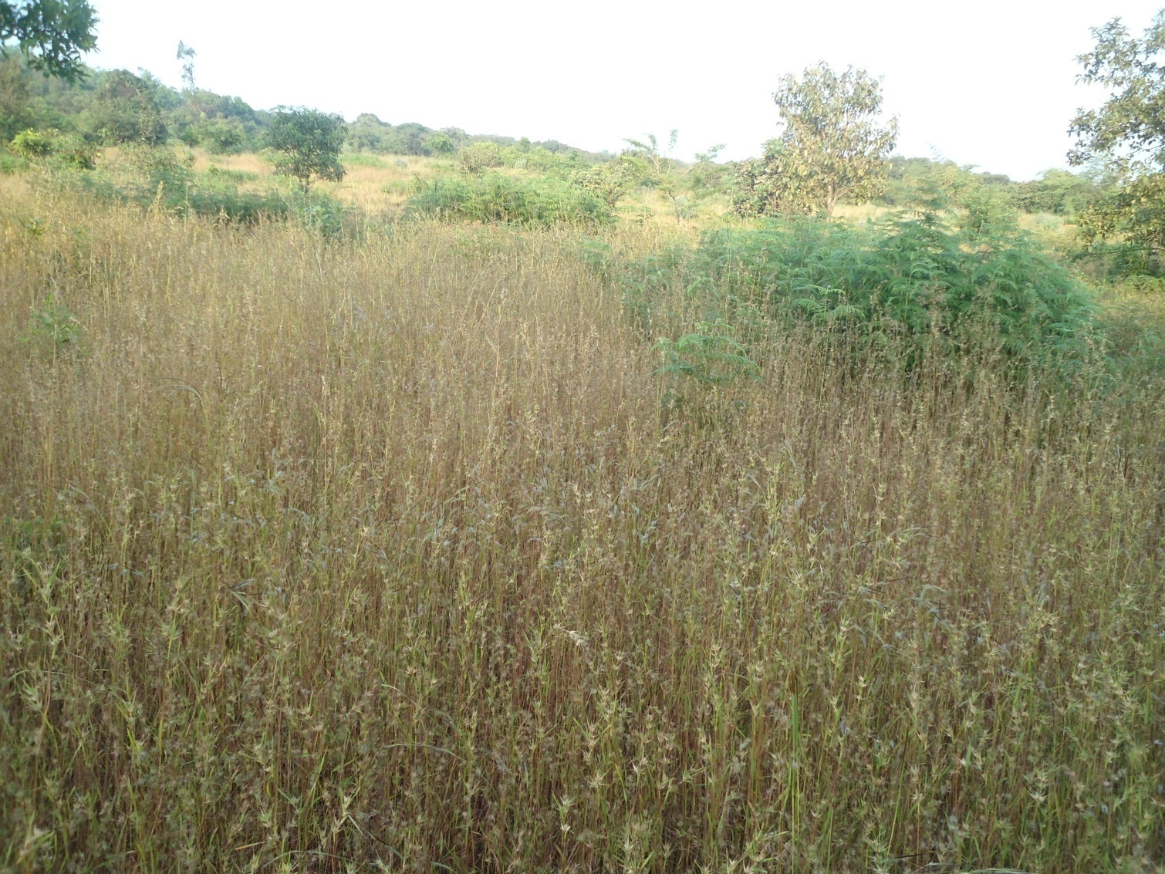
3 Months Rested Grass Land

Slide 13
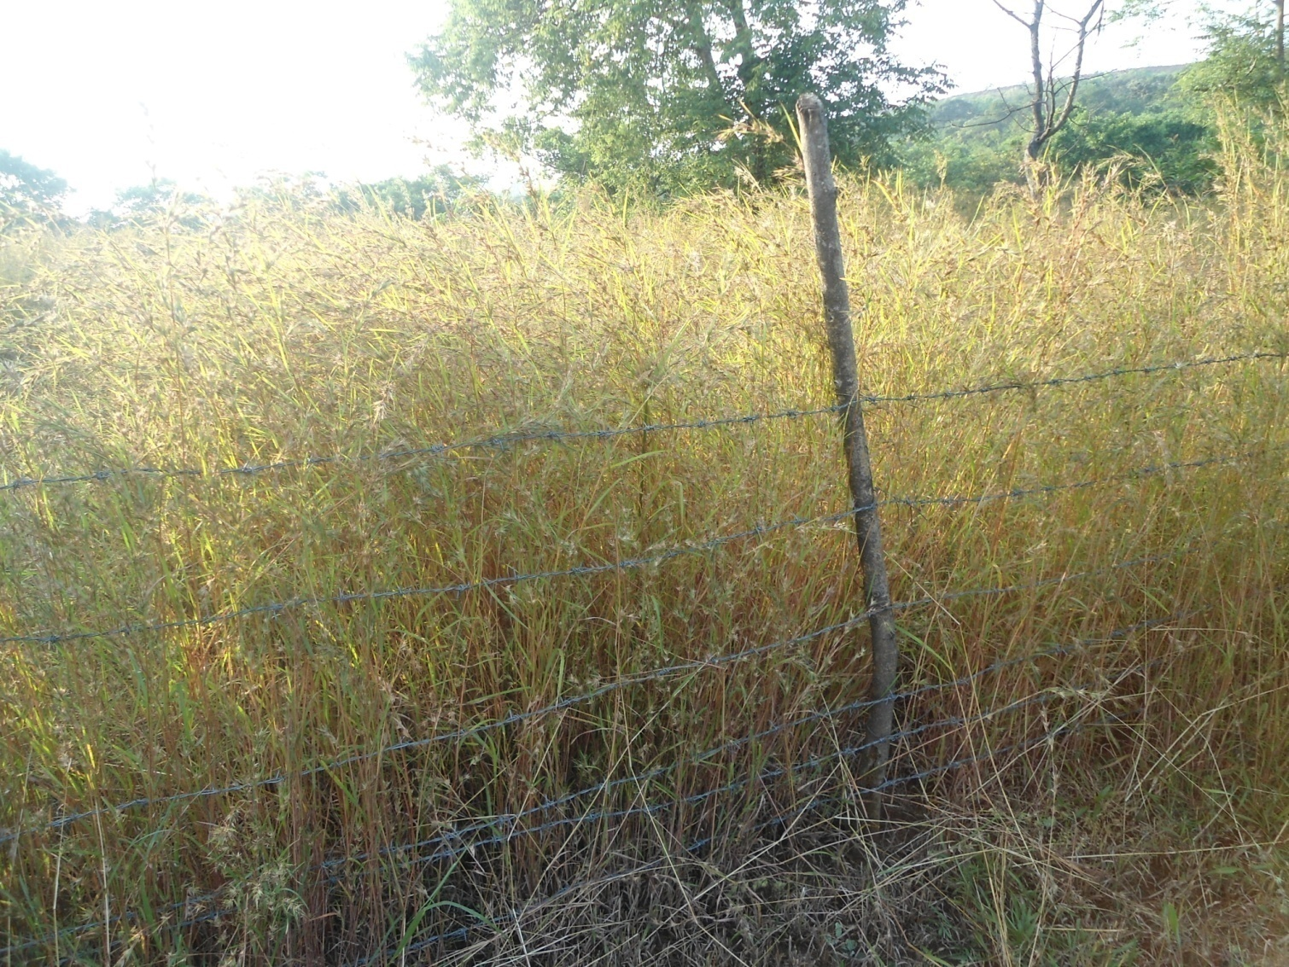
6 Months Rested Grass Land

Slide 14
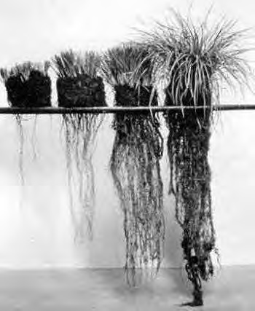
We Heal the Land by Grazing?
More roots in the soil
1. Longer rest periods mean more roots.
2. Feeds the micro-organisms.
3. Withstands droughts better.
4. Pulls minerals from deeper in the soil.

Slide 15
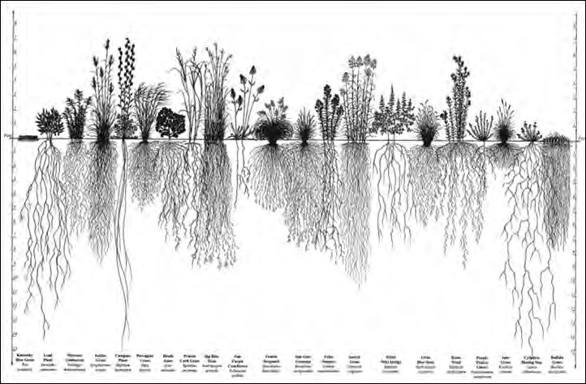
Root Diversity

Slide 16
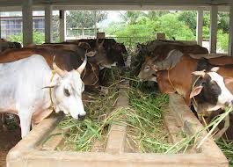
Working Against Nature
The animals are feeding without their normal movement

Slide 17
Working Against Nature
They are eating forages isolated from soil.
When the cows “recycle” the grasses ,the dung has nowhere to go where soil life forms will process it to perform their many benefitial functions-The dung goes to storage tanks.

Slide 18
Manure Pits
It is not natural-nature does not collect the excrement of her fauna in this way.
3 deleterious processes are induced
The rich exudation which leaves the heap, is like an opened artery: all goodness drains away.
Considerable loss of Nitrogen due to establishment of anaerobic flora.
Putrefaction as a result of lack of oxygen-release of noxious gases.

Slide 19
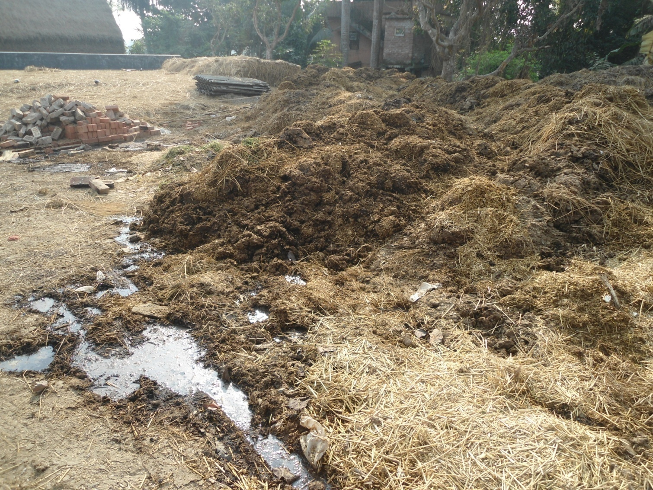
Manure Pit

Slide 20
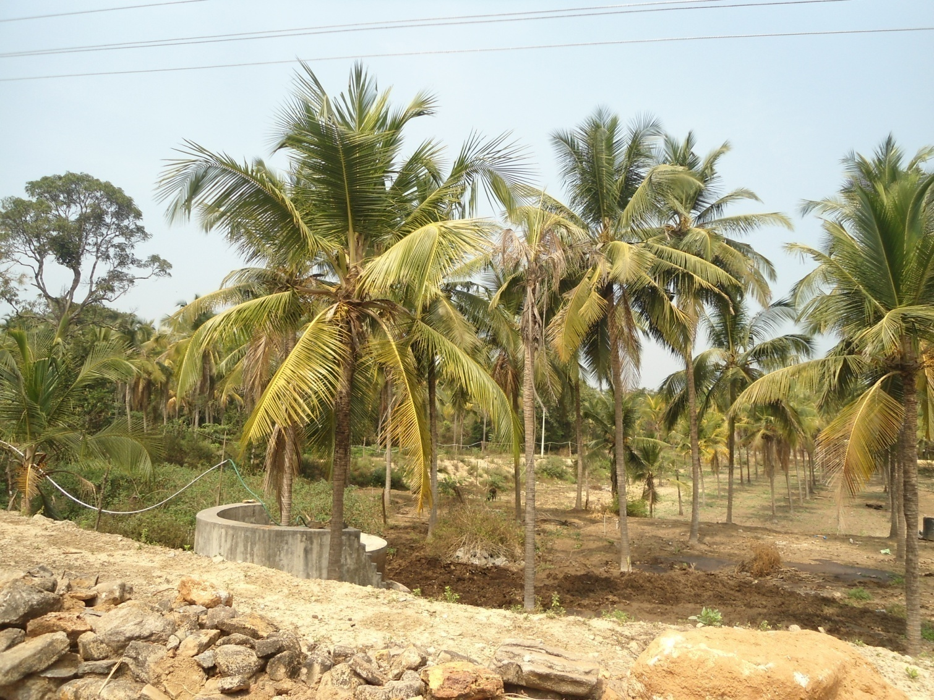
Adverse Effect of Dung Pits on Trees

Slide 21
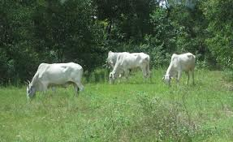
Working with Nature
The animals are feeding with their normal
movement on the land.

Slide 22
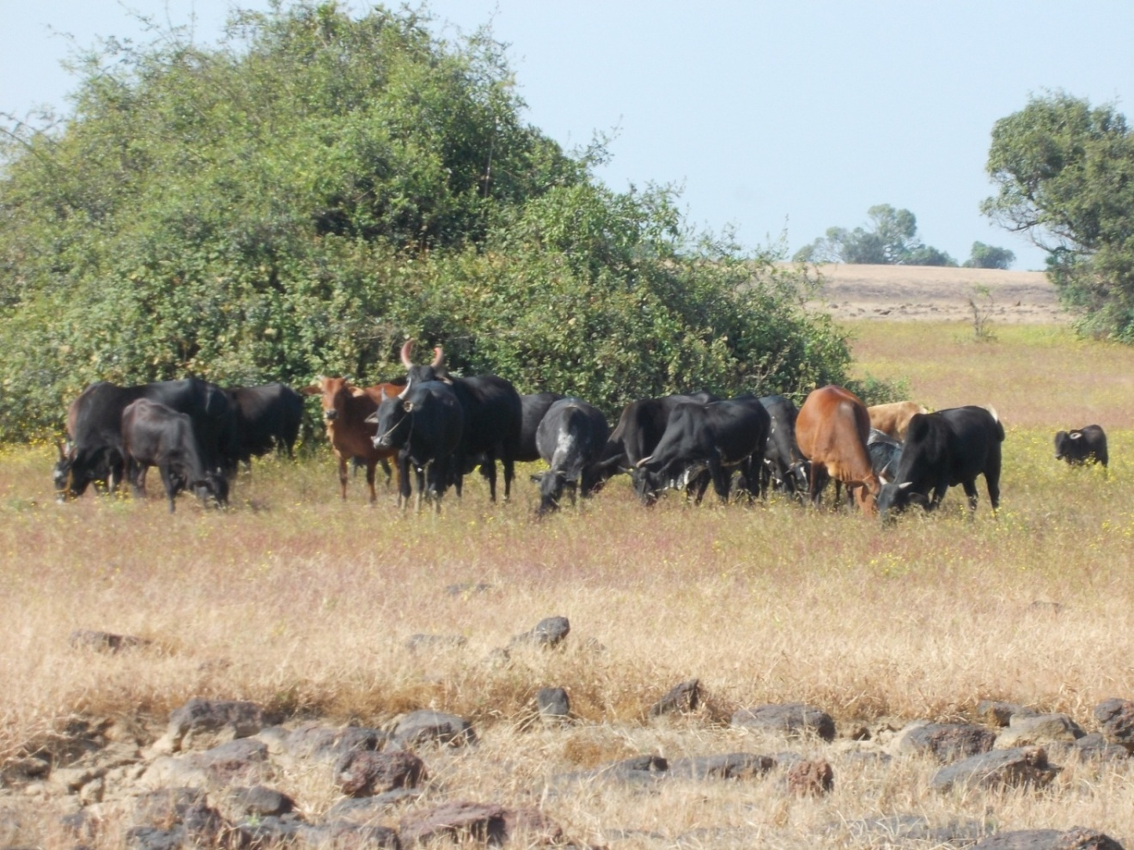
Working with Nature
They are recycling grass into dung which goes directly to the soil where it will be processed by soil life forms to perform their many beneficial functions.

Slide 23
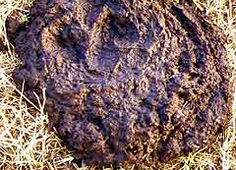
When Cows are Grazing
All the Dung and Urine Falls on the Ground

Slide 24
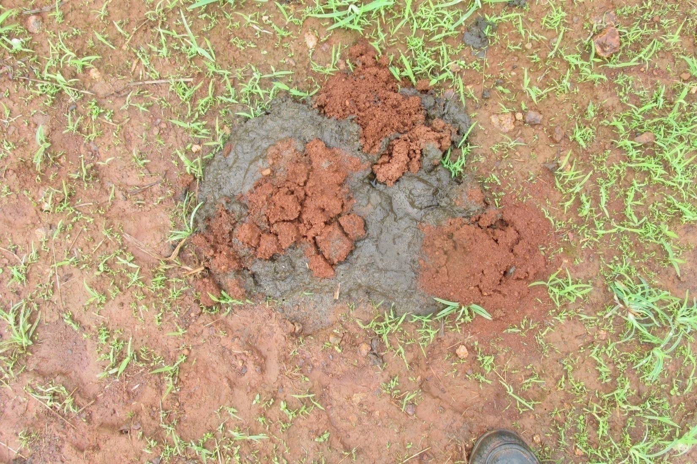
It is rapidly attacked by dung beetles, earth worms & other soilbiota

Slide 25
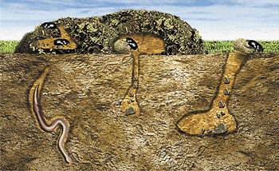
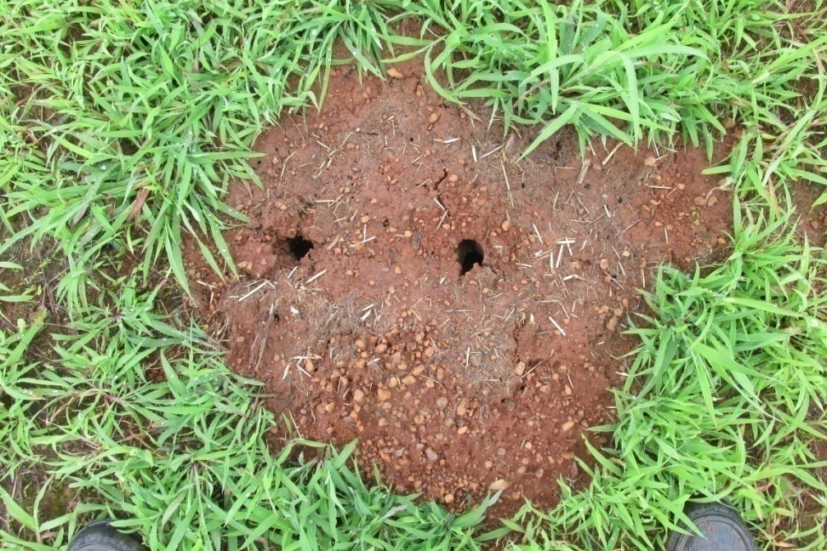
Taking it into various depths in the soil

Slide 26
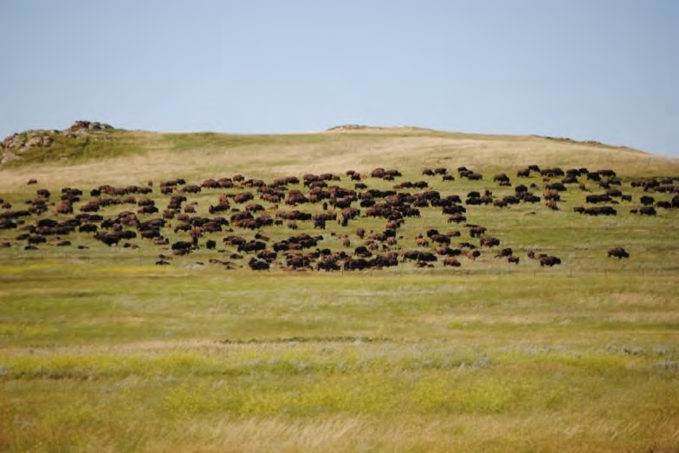
Building Soil

Slide 27
What is “Animal Impact”??
Animal impact is everything that livestock do to the land. This includes dunging, urinating, hoof action, rubbing, salivating, etc.
Animal impact is the most powerful tool we have to manage grassland resources. It effects utilization, reduces spot grazing, controls weed and brush competition, improves manure distribution, and produces seed/soil contact.

Slide 28
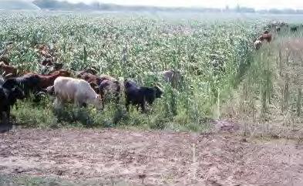
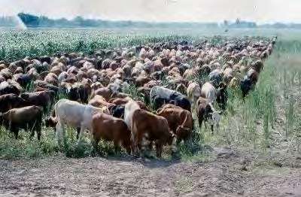
High Density Short Time

Slide 29
Stocking Density
No of cows | Weight(Kg) | Land area in acres | Stocking density/acre
40 | 16000 | 10 | 1600
40 | 16000 | 1 | 16000
40 | 16000 | 0.25 | 64000

Slide 30
Planning of Grazing
Area in cents | Cows | days | Hrs | Description
200 | 1 | 360 | 8 | 1 cow in 2 acres for 360 days grazing 8 hrs/day
50 | 1 | 90 | 8 | 1 Cow in 50 cents for 90 days grazing 8 hrs /day-The whole area is divided into 4 to give 9 months rest to each plot
16.67 | 1 | 30 | 8 | 1 Cow in 16 cents for 30 days grazing 8 hrs /day-The 3 month area is divided into 3 to get monthly grazing plot
0.56 | 1 | 1 | 8 | 1 cow in 0.55 cents for 1 day grazing 8 hrs /day-The monthly area is further divided to daily grazing plots
0.14 | 1 |  | 2 | 1 cow 0.14 cents for 2 hrs grazing to totally graze 8 hrs a day by further dividing 8hrs into 4 parts

Slide 31
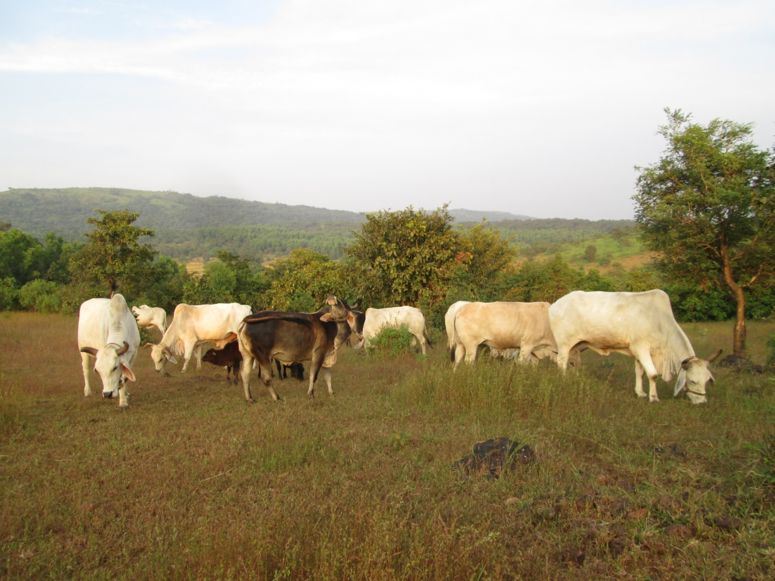
Working for us

Slide 32
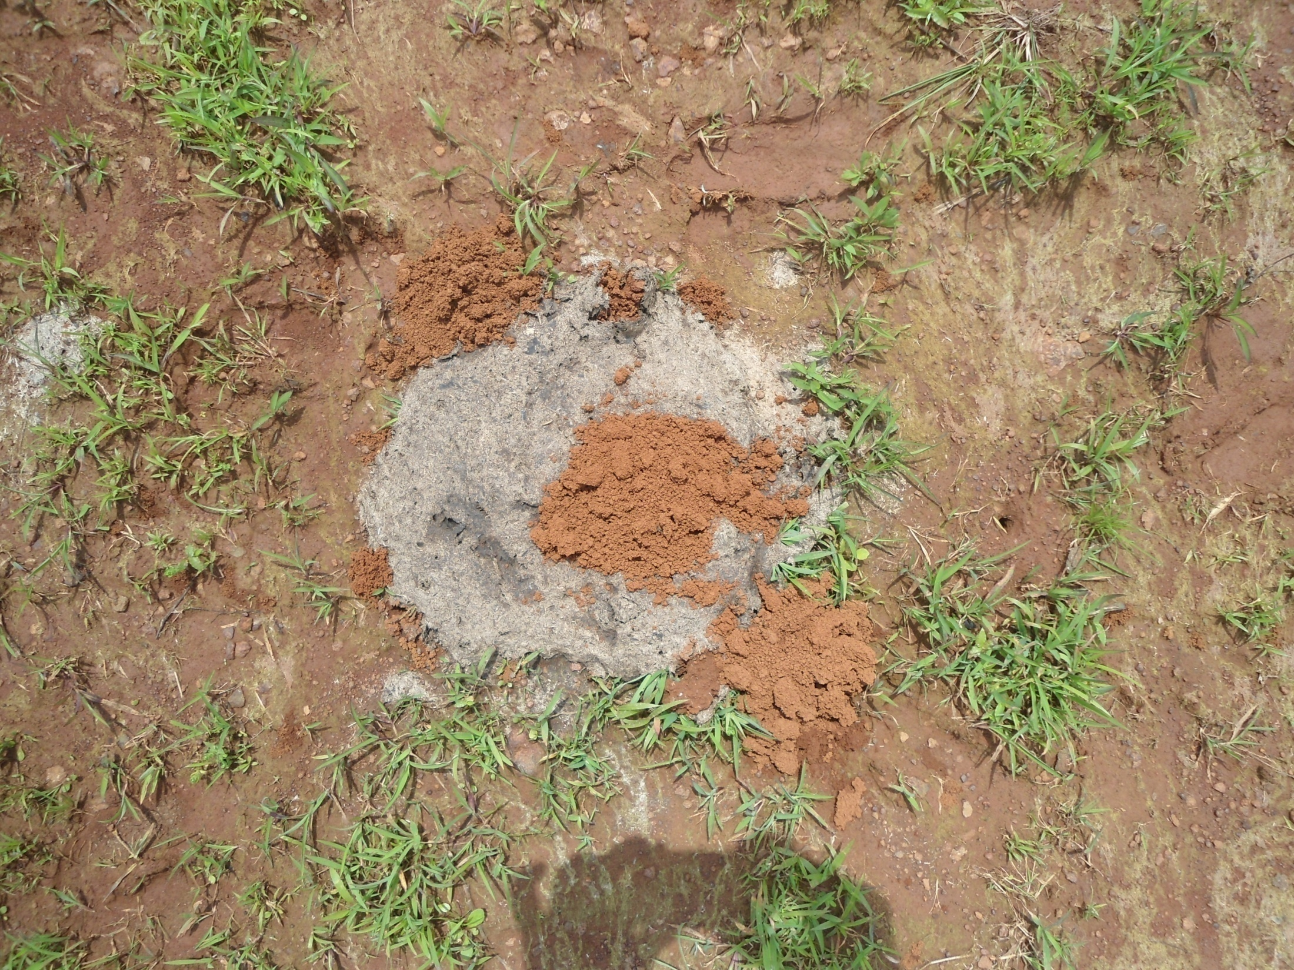
The Real Dung Removers

Slide 33
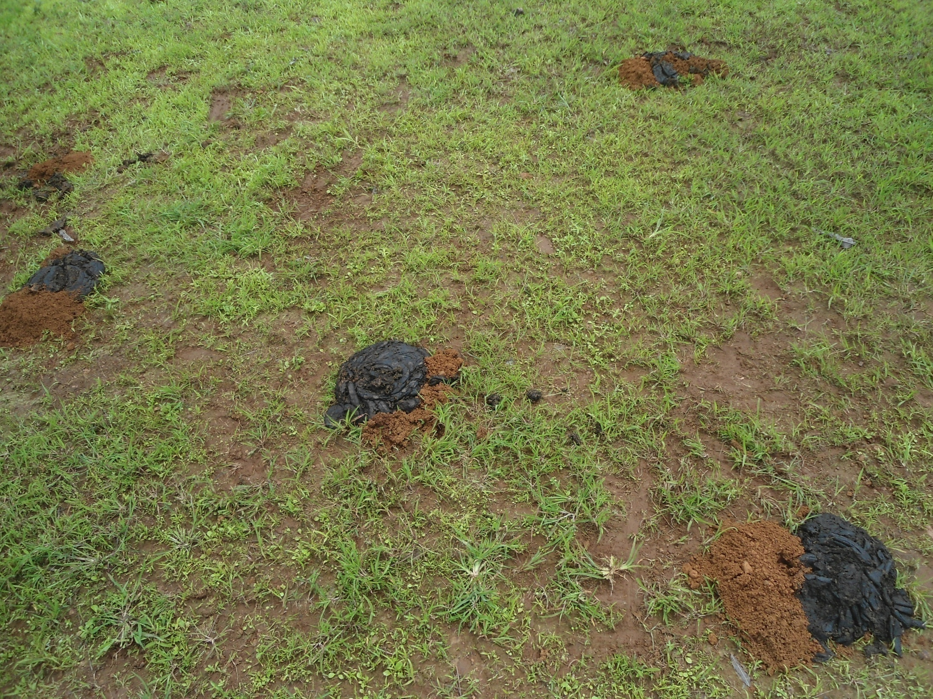
Dung Pads

Slide 34
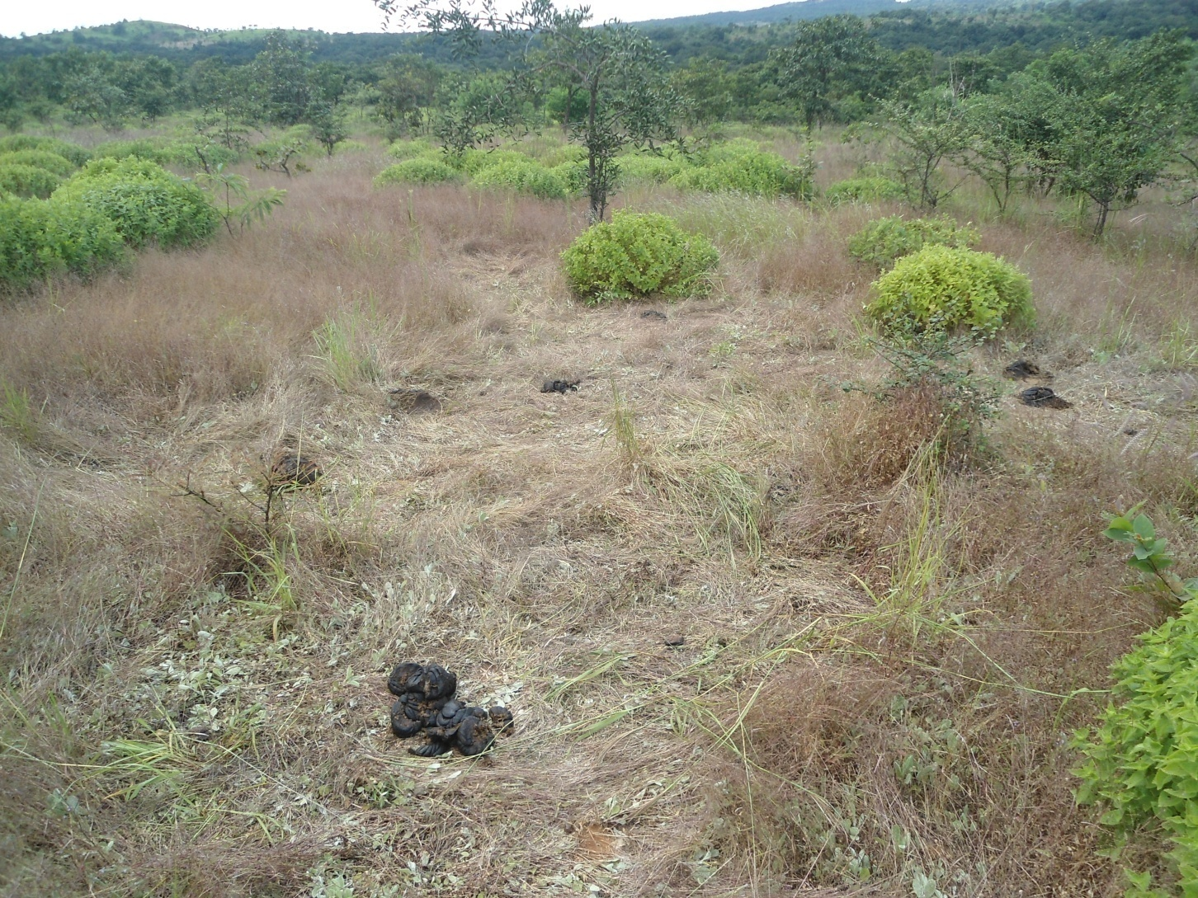
A Patch where Cows Just Rested

Slide 35
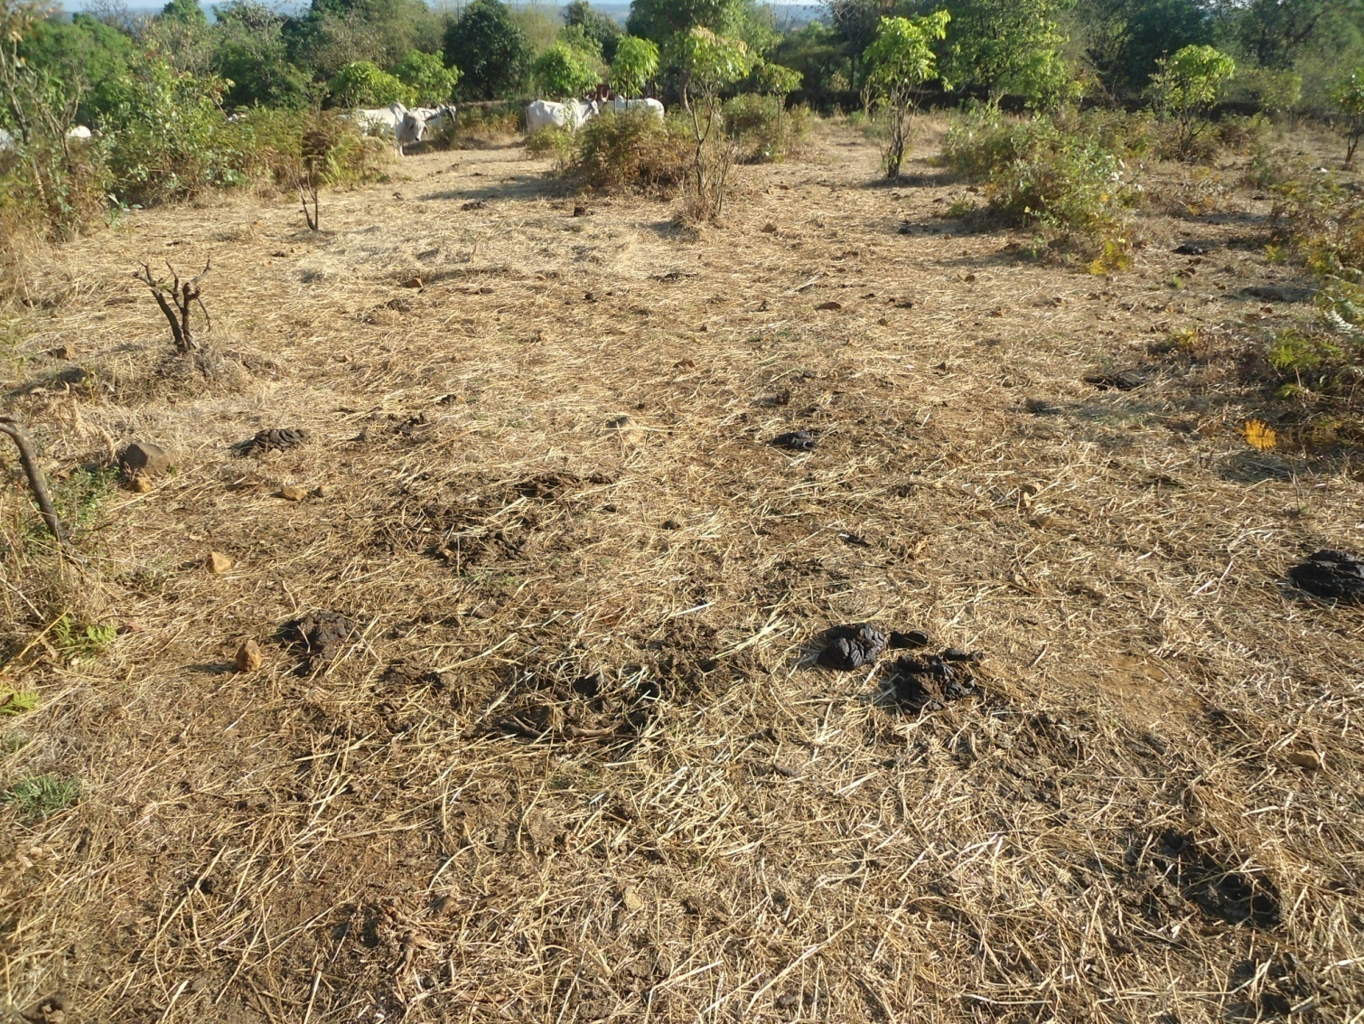
Full Tapping of Urine and Dung

Slide 36
The Tunnel Systems
Improves the physical structure of the soil
Increasing aeration
Reducing compaction
Bringing subsoils to the soil surface(Bio-turbation)
Incorporating organic matter into the soil

Slide 37
“Flow-on” Effect of the Improved Soil Structure
Increased water infiltration and reduced soil erosion
Increased biological activity (micro-organisms and earth worms
Stronger root growth leading to higher yields
Improved water holding capacity
Improved soil fertility b/c of bioturbation
Reduced surface ponding

Slide 38
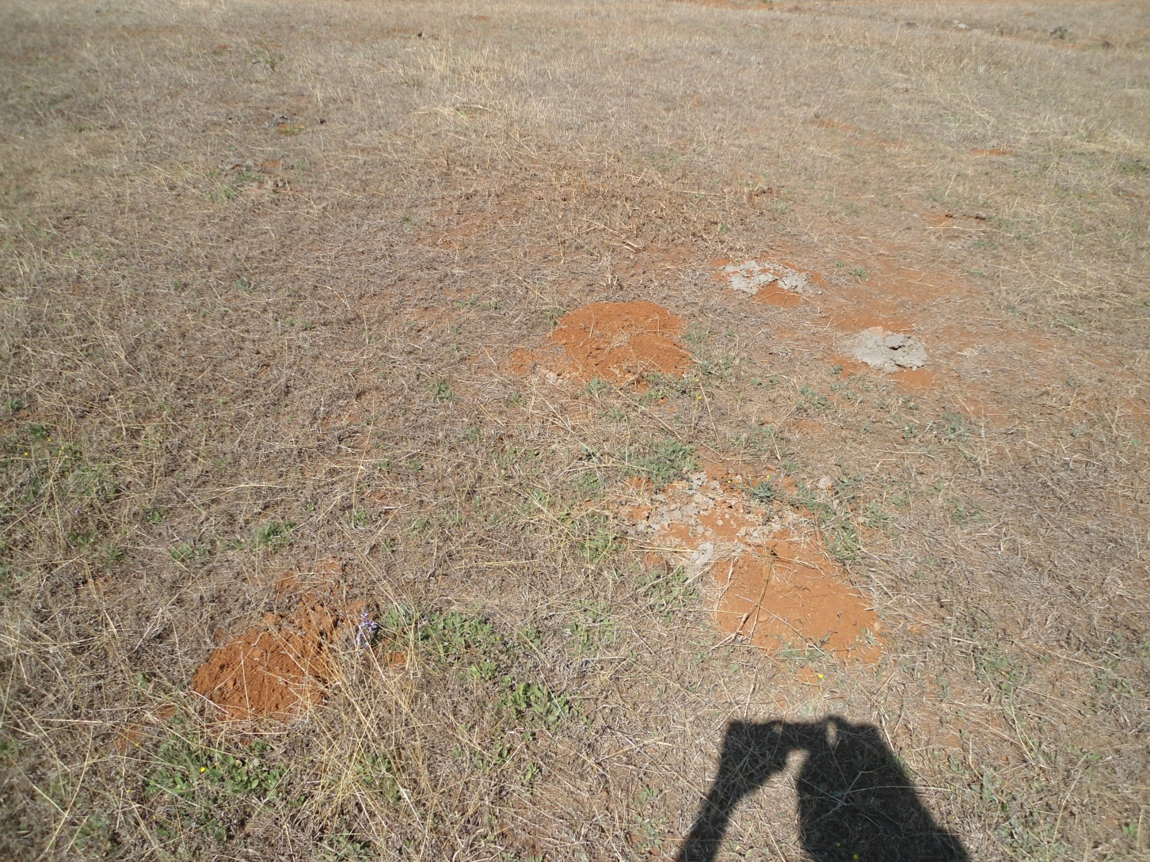
Bringing sub soil to the soil surface-Bio-turbation

Slide 39
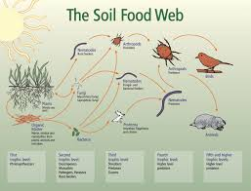

Slide 40
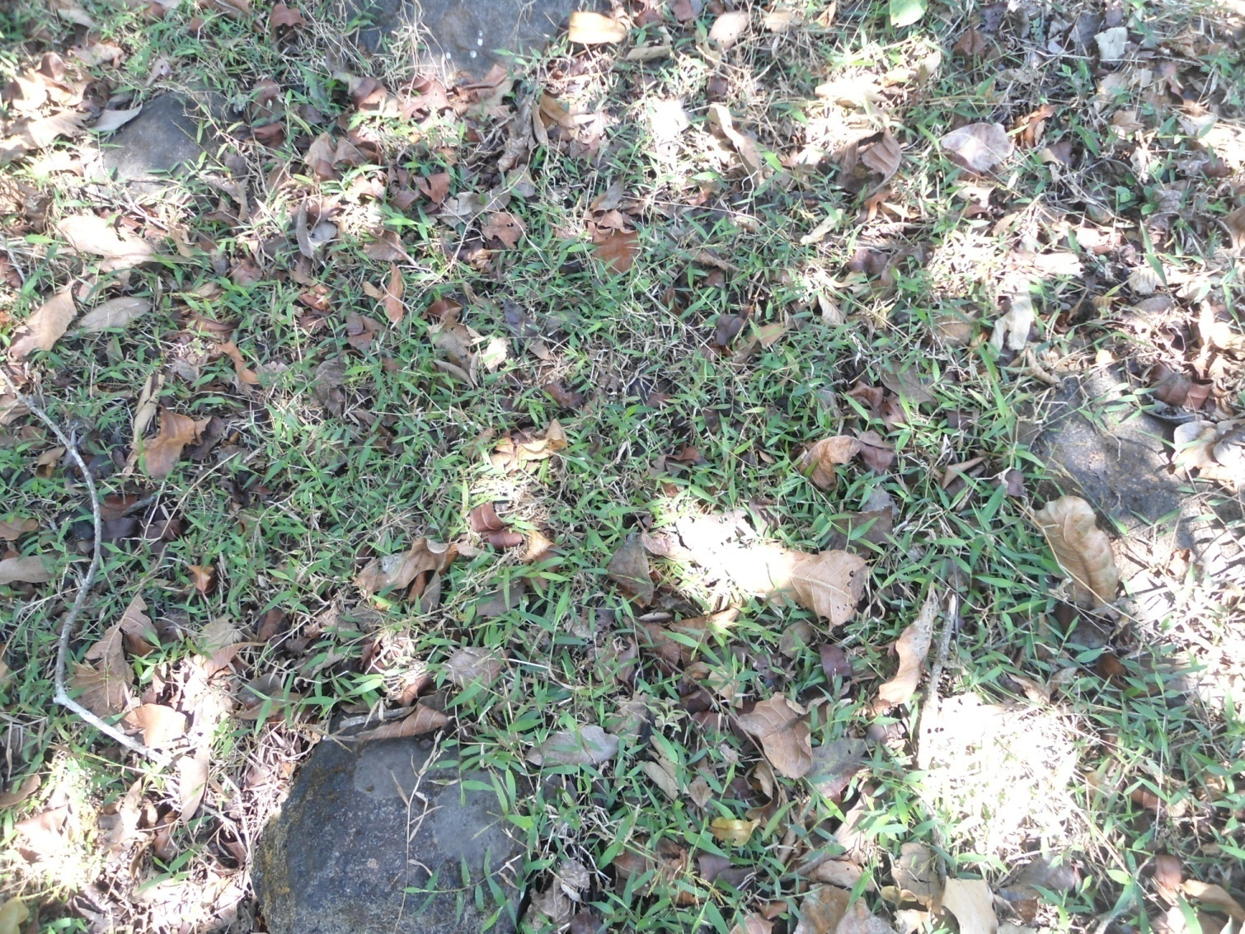
Moisture retention and growth of seasonal grass

Slide 41
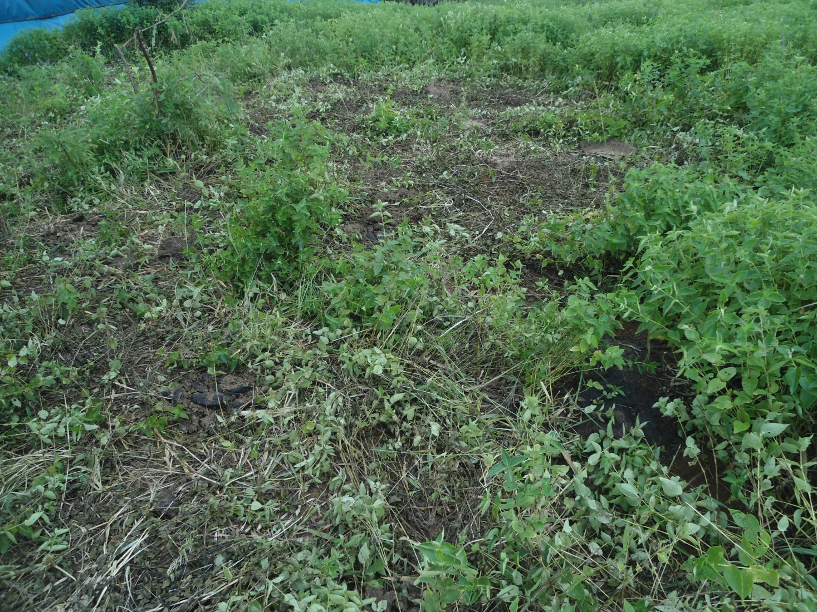
Clearing of bushes

Slide 42
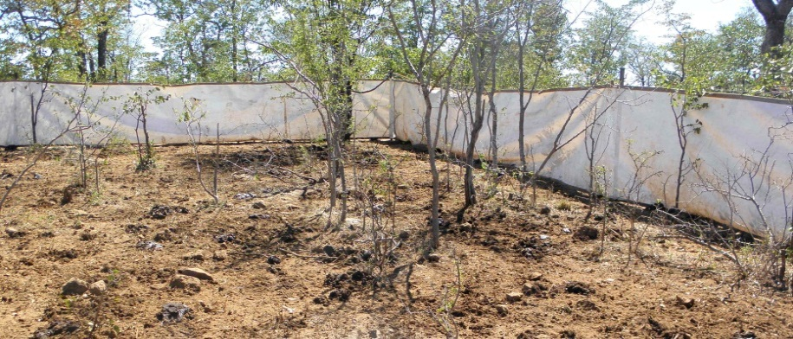
Living Tilling cum Fertilizing Machine

Slide 43
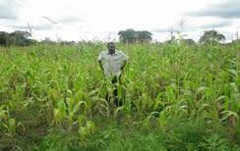
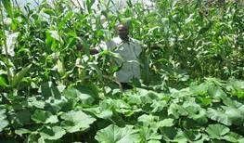
Effect of the Tilling and fertilizing machine

Slide 44
4.1.0.51 Atharva Veda 12-4-51
ये वशाया अदानाय वदन्ति परिरापिणः । इन्द्रस्य मन्यवे जाल्मा आ वृश्चन्ते अचित्या ।। अथर्व 12-4-51
वे लोग जो गोसेवा मे समय नहीं देते, जैविक कृषि, पञ्चगव्य इत्यादि का लाभ नहीं लेते, वे रुद्र के कोप से ग्रसित होते हैं।
Those ill advised who do not devote their time and labor for utilizing the family cows , and cultivate organic crops they suffer through
pests insects, diseases thrown by Rudra.

Slide 45
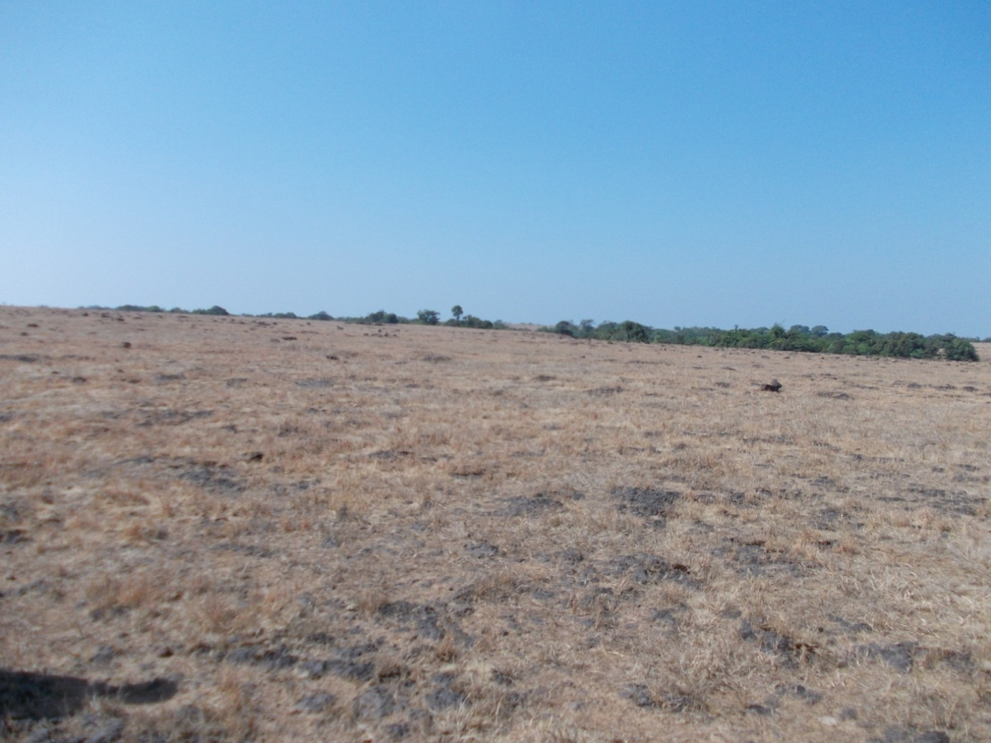
Impact of losing cows and grass lands leads to environmental dysfunction

Slide 46
Symptoms of environmental dysfunction
Eroding soil
Dying wells, springs rivers & lakes
Droughts and floods
Diseases of plants, animals and human beings
Invasions of Noxious plants and insects
Poverty-Social break down-Abuse of women & children
Drift to cities and slums
Petty crime-Violence-Blaming minorities-Victimisation-Genocide
Failing crops & economies-Local-National-Global
Wars, break down of governments-Failure of civilisations

Slide 47
Cow herd boys and their herds
Eliminates the symptoms of environmental dysfunction
Ensures your protection and the generations to come

Slide 48
Protect oneself by protecting Cows
“Humanity’s future hangs on a slender thread-Learning how to manage cows to address biodiversity loss/Desertification/Climate change “

Slide 49
As a career
If you are seeking a career that can assure you the real food(Fruits,nuts,milk),real water, real knowledge and real environment then the only career available to human being is “Cow care and land management”

Slide 50
Offering The Real thing to krishna
Only by protecting cows can we offer the “Real flower, real leaf,real fruit and real water “Krishna is speaking about in Bhagavat Geetha 9.26
“If one offers me with love and devotion a leaf, a flower,a fruit or water,I will accept it.”

Slide 51
Srimad bhagavatham 1.10.4
“The earth produces all the necessities of man”
Let us bring the cows back to the land

Slide 52
Selection of cows
All breeds thrive in local conditions and invariably deteriorate in alien environments.
Mother nature has designed breeds according to the area. Protect the cow of your region. They will adapt better and the diseases will be less.
please do not have any obsession for any breed of cow or any of its produce

Slide 53
1.1.3.1RigVeda10.27.20
एती मे गावौ प्रमरस्य युक्तौ मो षु प्र सेधीर्मुहुरिन्ममन्धि।
आपश्चिदस्य वि नशन्त्यर्थं सूरश्च मर्क उपरो बभूवान्‌।। ऋ 10.27.20
Farmlands with cows retain water and maintain healthy soil organisms, with twin bounties Urine and Dung of cows, which eliminate harmful microorganism and keep soil fertile like sun and rains make the land free from harmful pests make it fertile.

Slide 54
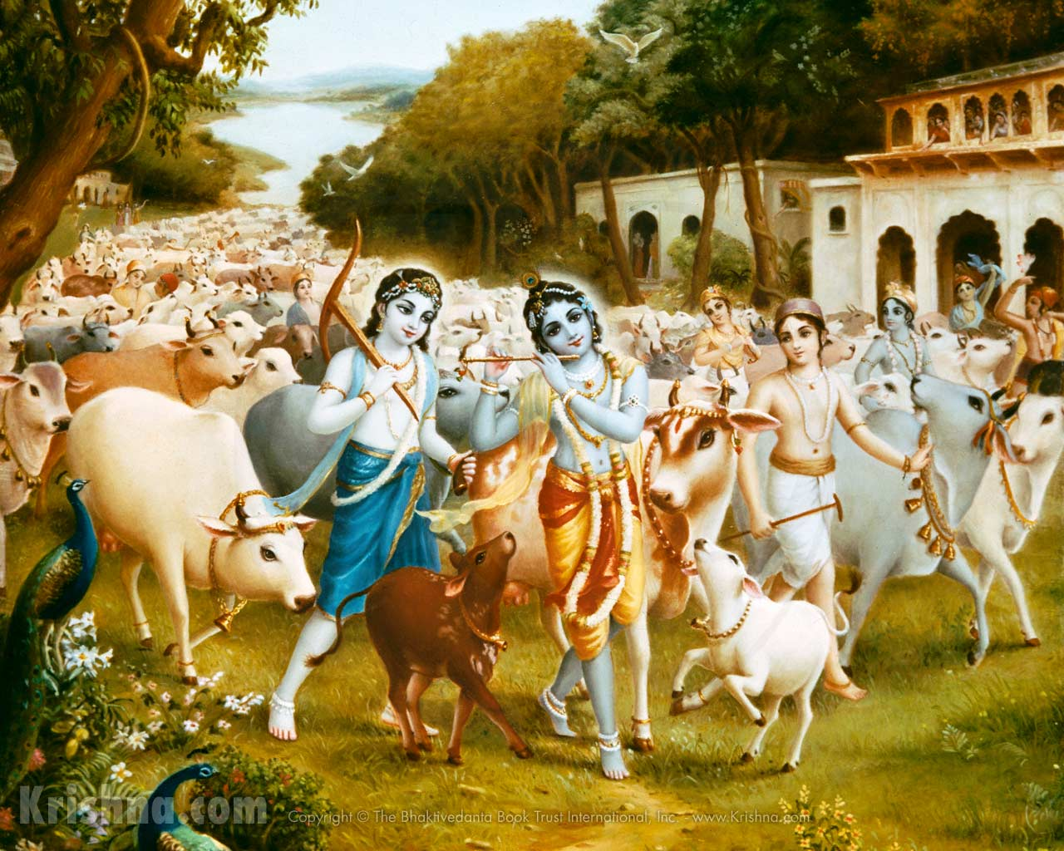
The model cow herd boy

Slide 55
The real cow products in holistic cow protection
Those which prevents
as against
Those sold to cure Diseases

Slide 56
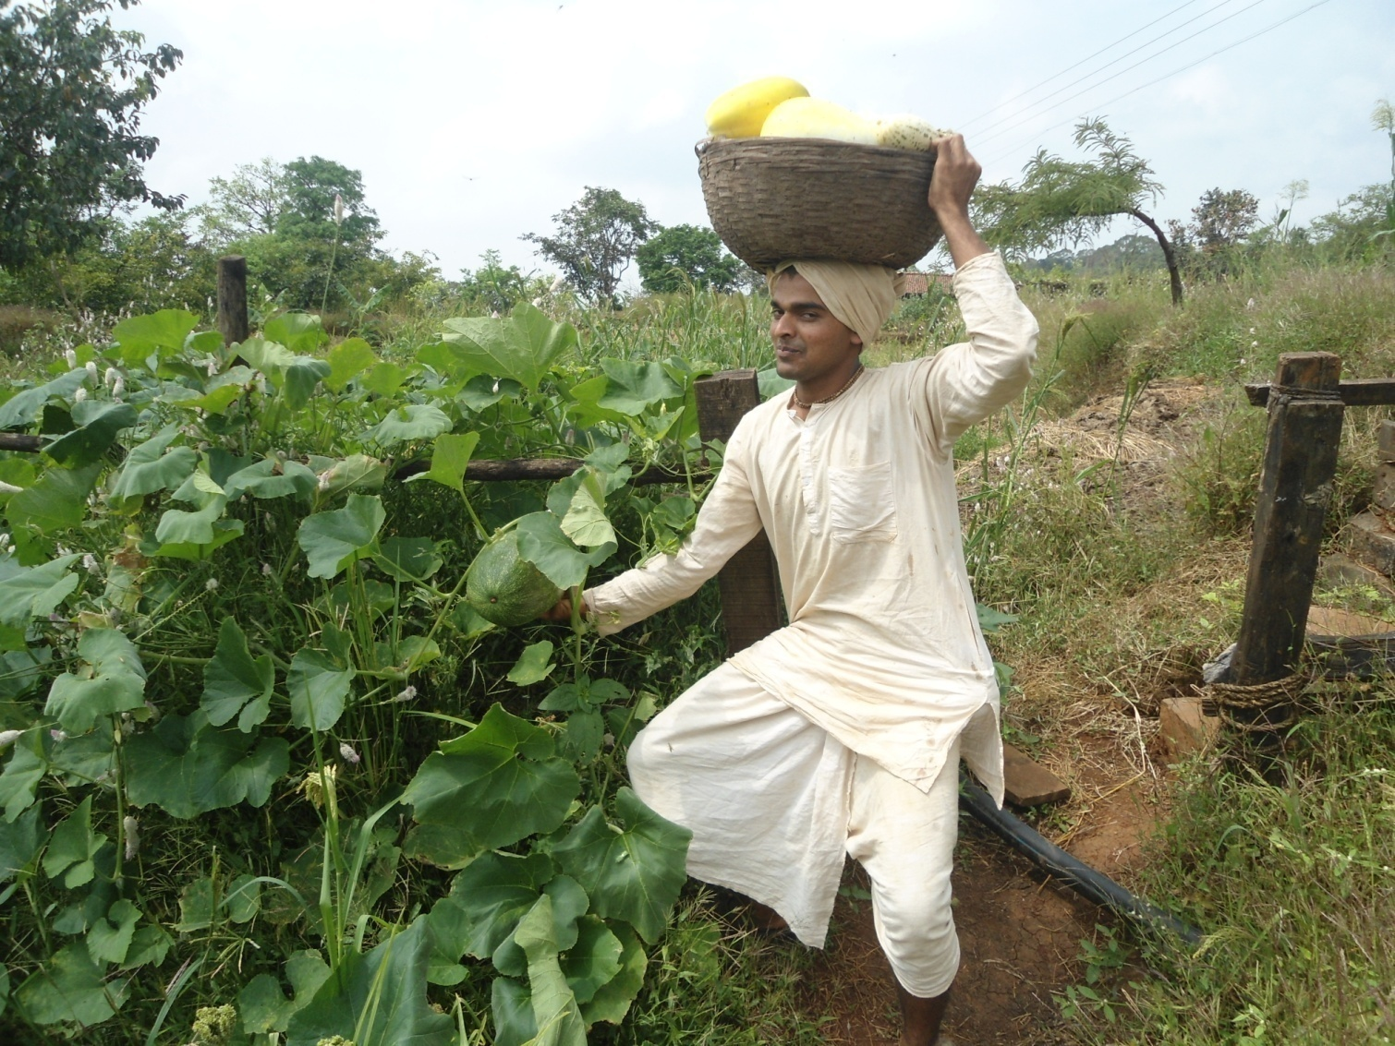
The real cow products

Slide 57
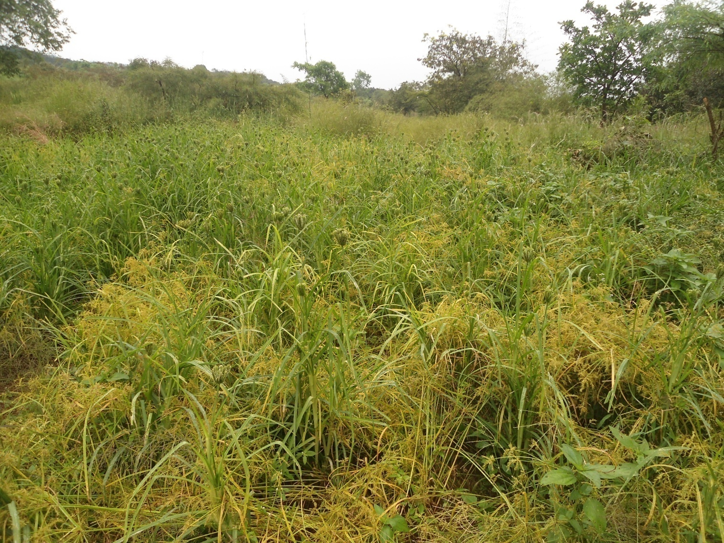
Millets

Slide 58
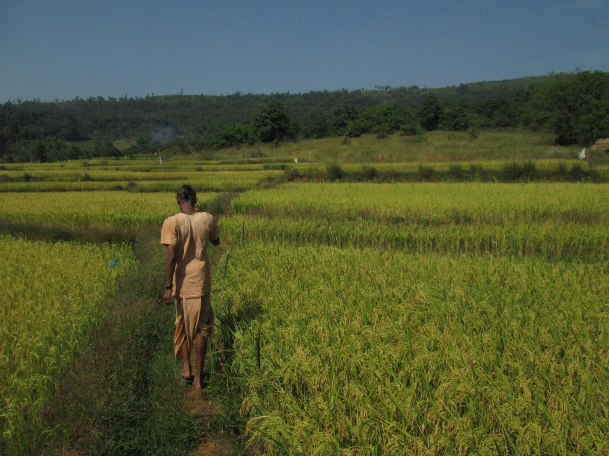
Grains

Slide 59
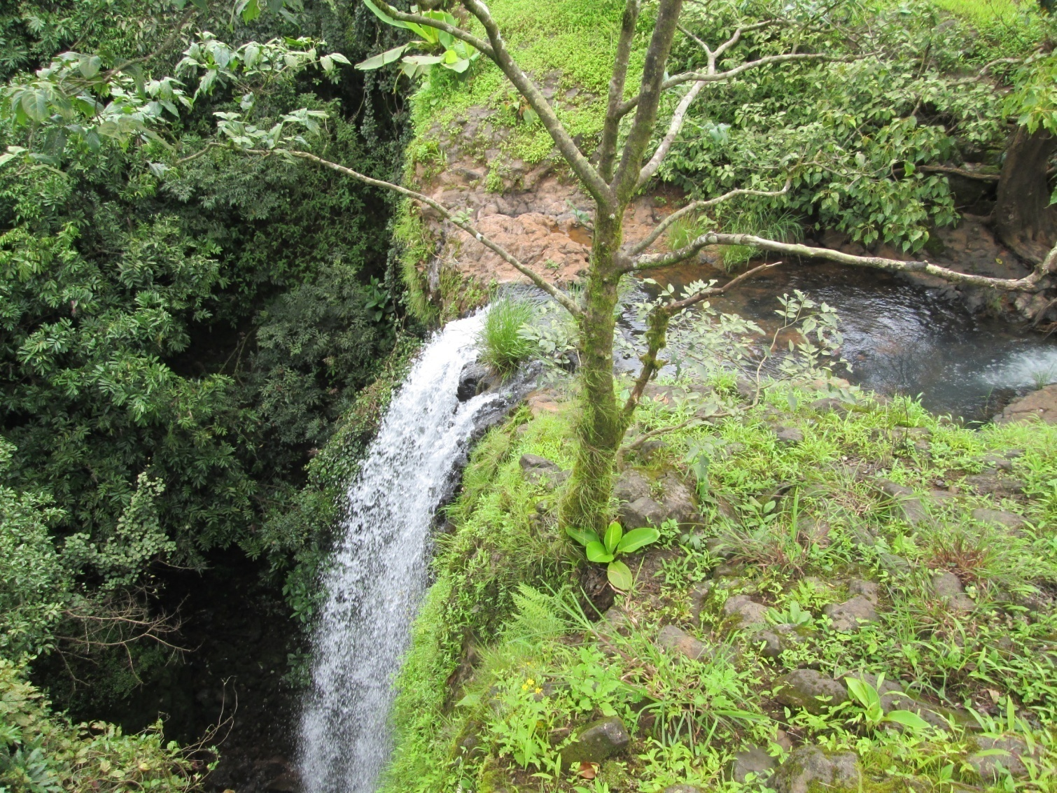
Water

Slide 60
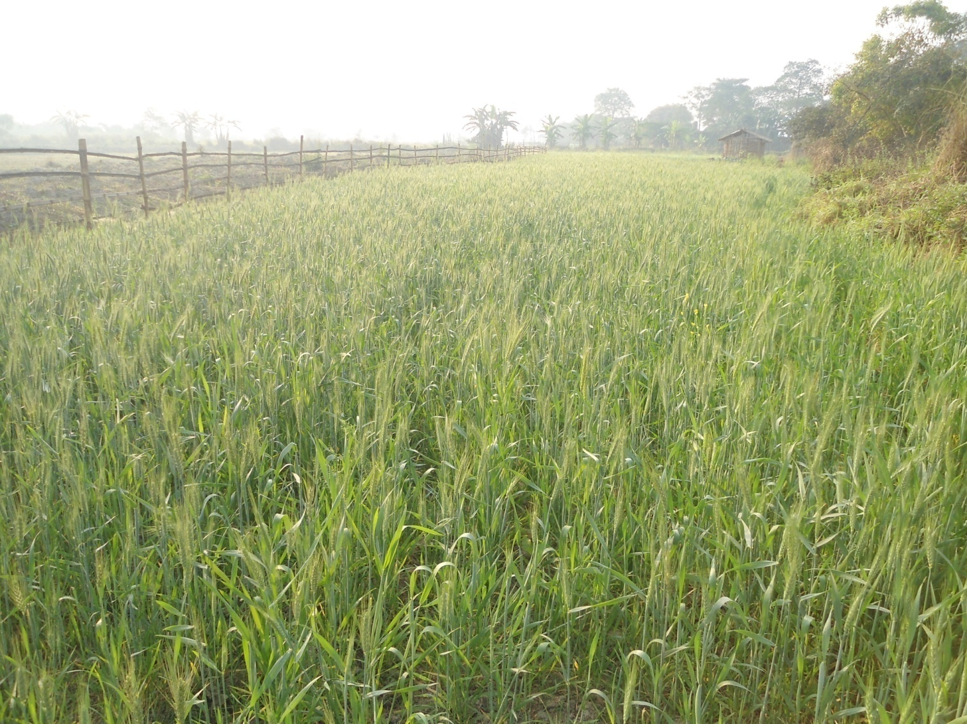
Grains

Slide 61
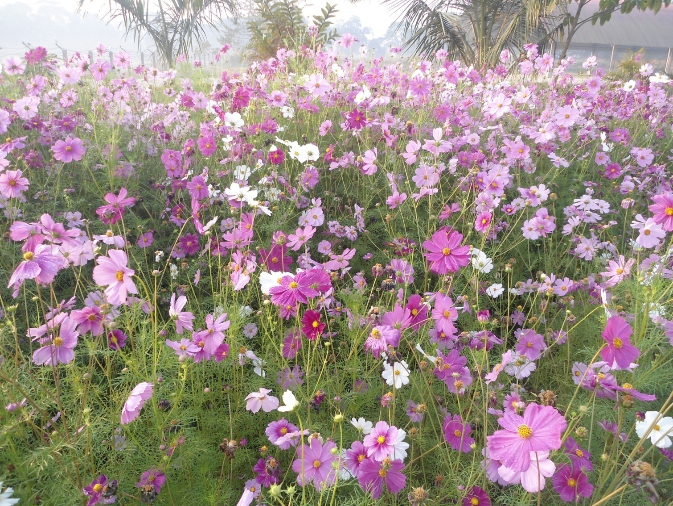
Flowers

Slide 62
Sreemad bhagavatham 1.10.4
Do they not require therefore a proper protection for a joyful life? By being fed with a sufficient quantity of grass in the field why should man kill cows for their selfless purpose?”

Slide 63
This was my dream
“So this was my dream. That a place should be there where we can get all nice foods, best of foods.milk.Krishna is fulfilling our desire”
Conversation,Toronto 21,June 76

Slide 64
Cow Protection
“The protection of cows . . . is not merely a religious sentiment but a means to secure the highest benefit for human society.”
Light of the Bhagavata 27 purport
Lecture, New York, 7 Apr. ’73

Slide 65
Cow Protection
“ the most important business of the human society ”
Lecture, Los Angeles, 4 Dec. ’68
Lecture, New York, 28 Mar. ’66
Lecture, Los Angeles, 5 May ’73
Lecture, London, 4 Aug. ’71
Lecture, London, 23 July ’73
Lecture, London, 25 Nov. ’73
Lecture, Hawaii, 15 Jan. ’74

Slide 66
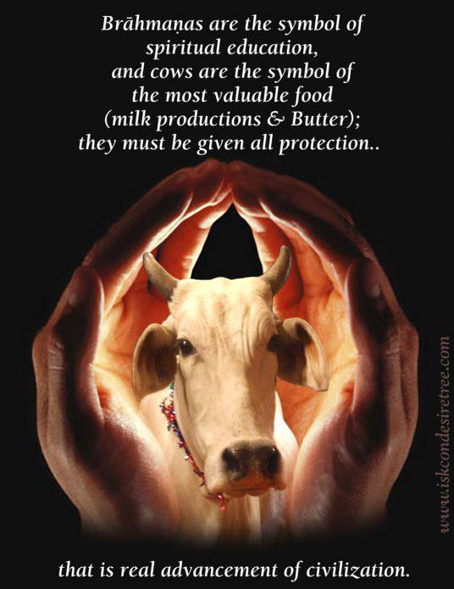
Ohm Surabhyae namah
Thank you

